Slide 1


Slide 2

Design a Flame Deflector Water Deluge System to Control Flow and Thermal Environment
Initial Seminar
Iftikhar Ahmed Bhutto
23 Ph.D. A.Math-008
Department of BS&RS (Applied Mathematics)
Supervisor Co-Supervisor Co-Supervisor
Prof. Dr. Feroz Shah Dr. Mukkarum Hussain Dr. Fozia Shaikh
Dept: of BS&RS General Manager Dept: of BS&RS
Mehran UET, Jamshoro SUPARCO, Karachi Mehran UET, Jamshoro
Directorate of Postgraduate Studies, Faculty of Science, Technology and Humanities, Mehran University of Engineering and Technology, Jamshoro, Sindh, Pakistan

Slide 3
Table Contents
Introduction
Motivation or scope of the study
Literature Review
Summary of Literature Review
Research Gap
Problem Statement
Aim & Objectives
Methodology
Significance of research
Work Plan
References

Slide 4
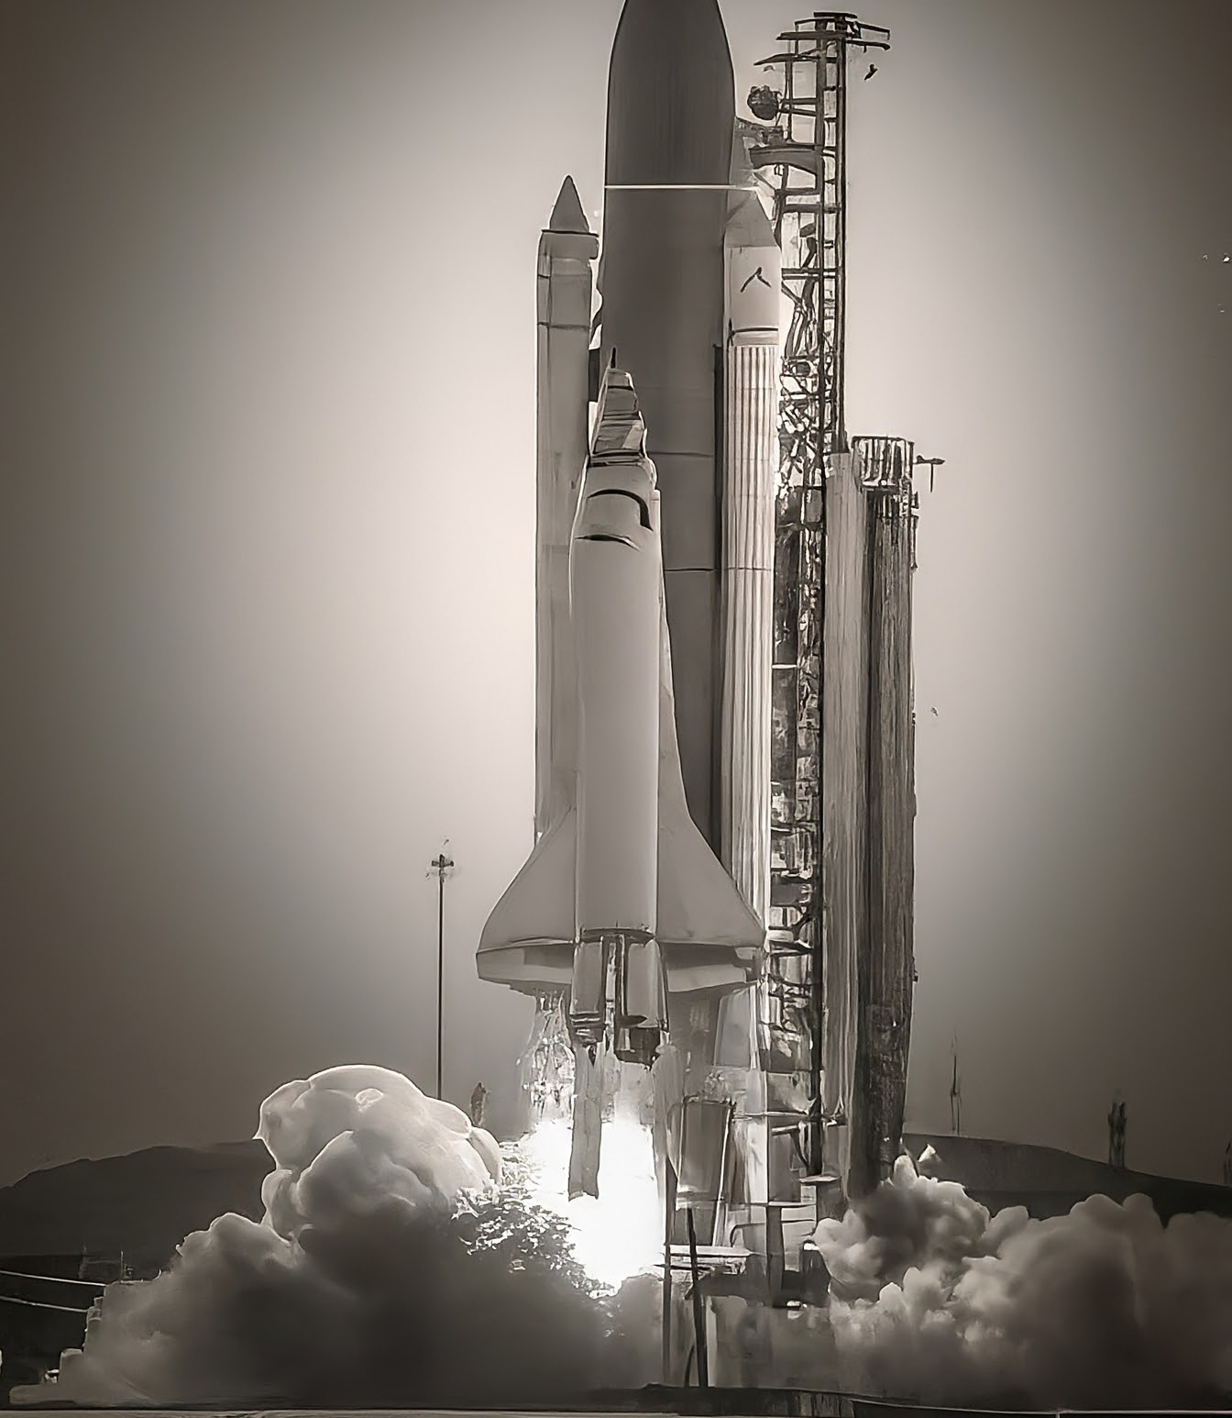
Introduction
Space exploration has been a driving force for scientific and technological advancements with space agencies, continuously pushing the boundaries of human knowledge and capabilities.
The flame deflector water deluge system plays a critical role in ensuring launch safety by mitigating the impact of intense heat and energy during liftoff.
In order to protect the launch pad and the surrounding infrastructure, this system releases a powerful water deluge through a network of pipes and nozzles.

Slide 5
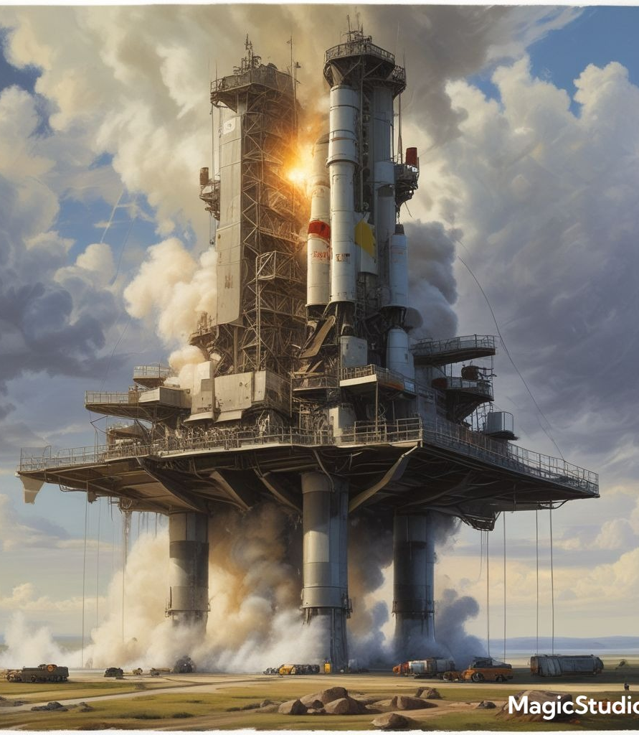
Continue…
The launch pad is covered with water by the water deluge system during ignition to improve the effectiveness of the flame deflector.
The rapid flow of water extinguishes fire and cools the pad, protecting it from damage caused by the intense heat of the rocket engines.
Several factors affect the efficacy of the water deluge system, including the flow rate, the coverage area, and the pressure of the water.
In order to achieve optimal performance, careful design and engineering are essential.

Slide 6
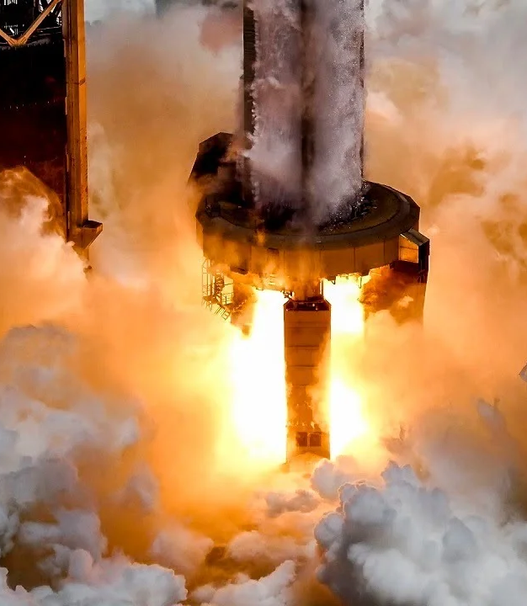
Continue…
Continuous research and development efforts are focused on optimizing the performance of the Flame Deflector Water Deluge System.
Innovations in materials, nozzle design, and water delivery mechanisms are being explored to further enhance launch safety and minimize environmental impact.
The Flame Deflector Water Deluge System stands as a cornerstone of launch safety, providing vital protection against the extreme conditions of liftoff.
Through ongoing advancements and meticulous maintenance, this system ensures the safeguarding of critical infrastructure and the success of space missions.

Slide 7
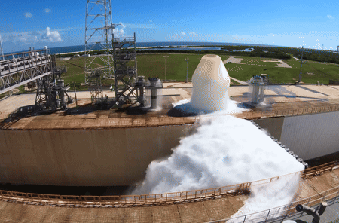
Continue…
The flame deflector serves as a barrier between the rocket engines and the launch pad.
It redirects the exhaust plume away from critical infrastructure, protecting the pad from intense heat and debris.
The integration of flame deflector water deluge systems into existing launch pad infrastructure presents engineering and logistical challenges.
Overcoming these hurdles requires collaboration and innovative solutions.
The water deluge mechanism involves releasing a large volume of water onto the flame deflector during rocket engine ignition.
Rapidly absorbs heat and creates a barrier between the exhaust plume and the launch pad, preventing damage.

Slide 8
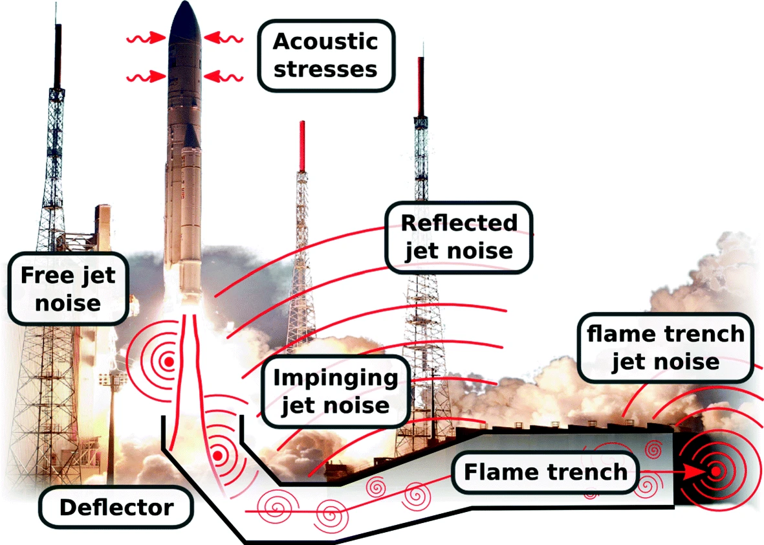
Motivation

Slide 9
Literature Review
Literature | Comments/Findings/ Limitations
Jiang et al., (2010) | Numerically investigated, the cooling effect of water injection on a high-temperature supersonic jet using a mixture multiphase model and vaporization mechanism. The cooling effect increased with the amount of water injected and decreased with the speed of the jet. The cooling effect was found to be more pronounced at low Mach numbers, the water injection is an effective way of cooling a supersonic jet.
Sachdev et al. (2010) | Examine the cooling spray nozzles by employing a method which combines the Eulerian formulation and the gas-phase equations. This method allows for the simulation of cooling spray nozzles at different pressures and flow rates. It can help identify optimal spray nozzle designs and pressures for maximum efficiency.
Vu et al. (2013) | Numerical investigation performed to simulate the water injection from the flame deflector and its interaction with supersonic rocket exhaust from a heavy-lift launch vehicle using a Eulerian dispersed phase model (EDP). The simulation results showed a decrease in the exhaust velocity and an increase in pressure.

Slide 10
Literature Review
Literature | Comments/Findings/ Limitations
Nili Bachchan et al., (2013) | Analysis of water-cooling effects on supersonic plume impingement was conducted to study the plume-induced environment resulting from SLS launch. The water-cooling method was effective in reducing the temperature of the MFD, but it had to be installed carefully to ensure maximum cooling.
Montazeri et al., (2015) | Analyzed the impact of turbulence model, particle number, and nozzle spray angle on the nozzle spray angle sensitivity analysis. The nozzle spray angle had the most significant impact on the spray angle sensitivity analysis. Furthermore, the turbulence model and particle number had a minor influence.
Jing Li et al., (2015) | Numerical simulations and experiments were conducted for a multiphase gas-liquid flow field using mixture multiphase model. A relationship is developed between the reduction of temperature on the bottom plate and the momentum ratio, which can be used to predict the cooling effect of water injection.

Slide 11
Literature Review
Literature | Comments/Findings/ Limitations
Sharma et al,. (2016) | Numerical methodology is developed to capture non-equilibrium multi-phase flow of water sprays in supersonic rocket plume environment. Analyze the effects of plate thickness, plate temperature, and plate pressure on multi-orifice plate cooling for deflector pit simulators. The mass transfer phenomenon based on Lee Model is used to capture evaporation-condensation physics
Raoult et al. (2018) | Numerical investigation was performed using CFD, which included a model to simulate water spray formation and dispersion in air flows and a numerical tool to simulate the impact of water spray on heat exchangers. The optimal water spray parameters and to understand the effect of water spray on heat exchanger efficiency. The water spray dispersion was affected by air velocity and the type of heat exchanger.
Lamini, O., et al. (2018) | Experimental studies were performed to understand the thermal performance of the heat spray cooling with a moving nozzle. Nozzle speed and liquid flow rate had a significant effect on heat transfer. The heat transfer rate was higher when the nozzle speed and liquid flow rate were higher. The structure of heater surface and heat flux also affected heat transfer.

Slide 12
Literature Review
Literature | Comments/Findings/ Limitations
Fabien Raoult et al., (2019) | Investigate the effects of Eulerian spray dispersion and the open source CFD simulation tool Code Saturne on the pre-cooling of water sprays over a heat exchanger. Analysis of the parametric effects of water evaporation and air cooling on a specified surface. Several factors are considered, including relative humidity, spray angle, water mass flow rate, and droplet size distribution.
Ruan et al. (2019) | Experiments and numerical simulations were conducted to investigate the influence of operational parameters on liquid nitrogen suppression systems. Reducing the diameter of the condensate drop provided evaporative cooling more effectively than increasing the velocity. The diameter of the drop should be minimized for better suppression of the fire, the velocity should be controlled to ensure the most effective cooling.
Al-Zubaydi, et al., (2019) | Experimental evaluations were conducted to determine the effects of the water-spraying mode on the IEC unit. A novel water-spray mode was developed for indirect evaporative cooling. IEC's performance was examined in relation to operating parameters. An empirical correlation was derived from the experimental data.

Slide 13
Literature Review
Literature | Comments/Findings/ Limitations
Zhitan Zhou et al., (2020a) | Investigates the thermal environment between the frozen and reaction plumes of liquid rockets at different altitudes during afterburning. Identify an effective mathematical model for comparing the characteristics of exhaust plume flow fields at different flight altitudes with and without afterburning.
Saman Salehian et al., (2020) | To investigate the noise reduction mechanism, the ground plate injection of water is modeled using the VOF multiphase model. Numerical approach successfully resolves the acoustic field and is free of reflections at the boundary. The radiated sound can be captured with a feasible number of grid points using URANS near the walls, but LES with fine grid elsewhere.
Zhitan Zhou et al., (2020b) | Analyzes the distribution of temperature in the flame deflectors at different locations of the cooling holes. To determine the effects of water cooling on rocket plume impingement at high temperatures, two-phase simulations have been conducted using different locations of cooling holes. A large spray flow rate would negatively affect the flame deflector if water was spouting from the nozzles near the apex due to high velocity combustion gas blowing it away.

Slide 14
Literature Review
Literature | Comments/Findings/ Limitations
Chenyu Lu et al., (2021) | Investigates the temperature distributions on the launch pad with the two different water spray systems. The findings reveal that with the first-level water spray system, the overall temperature of the launch pad experiences a significant drop. The plume's influence causes a reduction in the cooling area for each nozzle, particularly closer to the central zone, due to the rocket plume dispersing most of the injected water, the temperature in the central area sees minimal reduction.
Abhishek Sharma et al., (2022) | Numerical investigation performed to optimize the quantity of water injected from two planes by employing different combination of circular nozzles. A multi-phase computational fluid dynamics (CFD) methodology is developed for design of water-cooling jet configuration of deflector facility. Identified the cooling mechanism required to safely operate the facility within physical constraints and available resources.
Zhitan Zhou et al., (2022) | Numerical simulation was performed under eight different injection velocities of water while considering the afterburning effect of the rocket impingement jet. In the presence of an aqueous jet velocity of 20 m/s, the maximum deflector temperature was 2535 K, which was 20.58% lower than that of the dry plume.

Slide 15
Literature Review
Literature | Comments/Findings/ Limitations
Manman Zhang et al., (2023) | Analysis of the cooling mechanism and effect of this scheme is conducted based on numerical simulations of the gas flow field under different spray speed conditions. New scheme of vertical upward water spray pipes is proposed in the deflector to solve the ablation problem of the launcher during missile launch and to reduce the complexity of the original water spray system. The maximum temperature of the gas flow drops from 3100K to 2100K, and the cooling range reaches more than 30% in the gas flow field with water spraying.
Yifei Su et al., (2023) | Investigate the gas flow characteristics of the CZ-8X rocket during offshore launching with and without seawater spray, as well as the thermal environments of the deck surface under different flight heights and spray velocities. The spraying velocity can be reduced appropriately after reaching 30 m and to 15 m/s before the take-off height reaches 40 m. However, the spraying position is fixed.
Zhou, Zhitan et al., (2023) | Investigate the afterburning effect on the thermal environment of the deflector with uplift angle of 6. Regarding thermal environment improvement, exhaust gas guidance, and jet stability, the deflector with an uplift angle of 6 exhibited excellent performance with and without water injection. Water injection and deflectors with an uplift angle of 6 showed excellent performance.

Slide 16
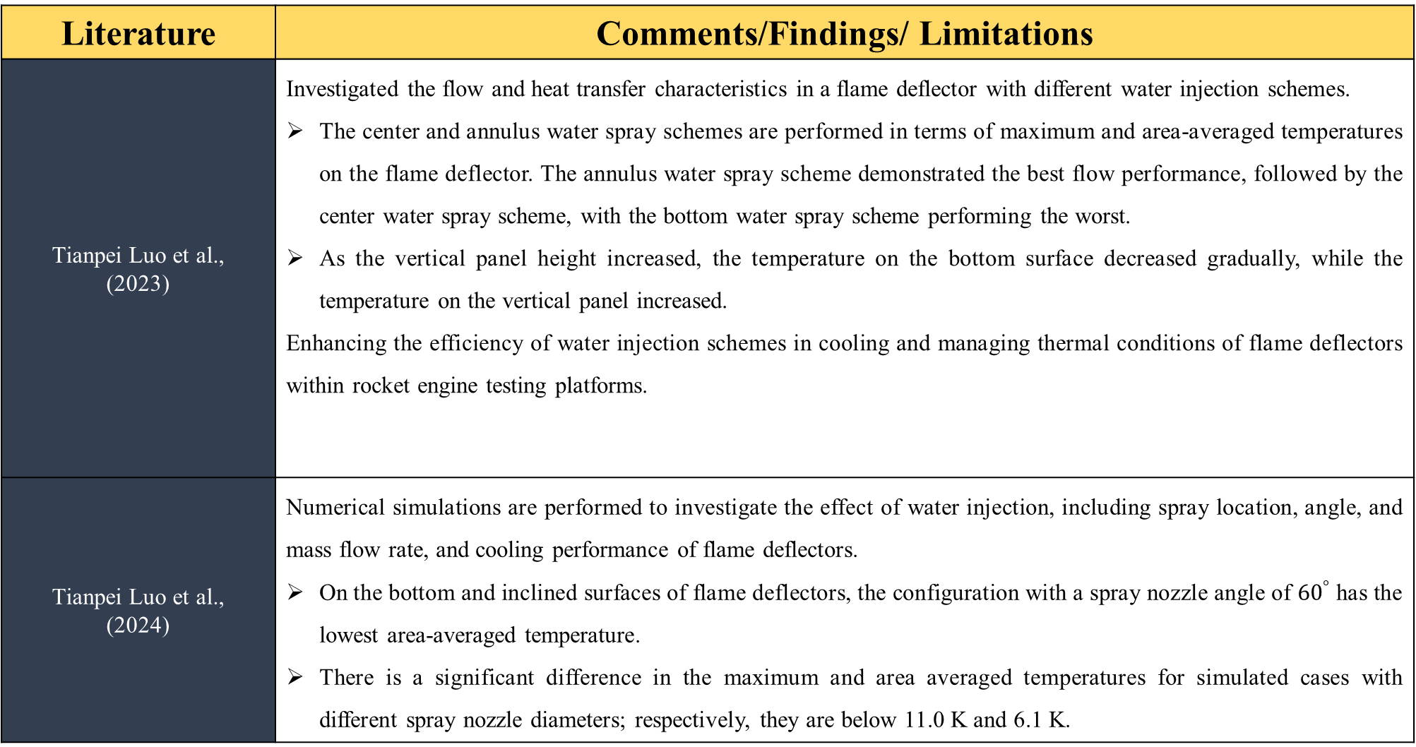
Literature Review
Literature | Comments/Findings/ Limitations
Tianpei Luo et al., (2023) | Investigated the flow and heat transfer characteristics in a flame deflector with different water injection schemes. The center and annulus water spray schemes are performed in terms of maximum and area-averaged temperatures on the flame deflector. The annulus water spray scheme demonstrated the best flow performance, followed by the center water spray scheme, with the bottom water spray scheme performing the worst. As the vertical panel height increased, the temperature on the bottom surface decreased gradually, while the temperature on the vertical panel increased. Enhancing the efficiency of water injection schemes in cooling and managing thermal conditions of flame deflectors within rocket engine testing platforms.
Tianpei Luo et al., (2024) | Numerical simulations are performed to investigate the effect of water injection, including spray location, angle, and mass flow rate, and cooling performance of flame deflectors. On the bottom and inclined surfaces of flame deflectors, the configuration with a spray nozzle angle of ${60}^{°}$ has the lowest area-averaged temperature. There is a significant difference in the maximum and area averaged temperatures for simulated cases with different spray nozzle diameters; respectively, they are below 11.0 K and 6.1 K.

Slide 17
Summary of Literature Review
In the development of rocket engines, ground tests are essential for verifying design feasibility and evaluating the engine's efficiency and performance.
Several studies have been conducted to examine the thermal-hydraulic performance of flame deflectors incorporating water spray systems.
Limited investigation into the long-term durability and maintenance requirements of flame deflectors equipped with water spray systems.
Limited study on the environmental impacts of using water spray systems in rocket engine testing.
Lack of detailed cost-benefit analysis comparing traditional experimental studies with numerical simulations and reduced-scale tests.
Lack of analysis of complementary methods to water spray cooling for mitigating heat damage to flame deflectors.
The lack of study on mathematical and numerical modeling methods to investigate the reduction of flame deflector temperatures using water deluge systems.
Insufficient exploration of potential challenges or limitations in implementing water spray cooling systems on offshore rocket launching platforms.

Slide 18
Research Gap
It is observed from the literature that there are several key problems or areas of lack on flame deflectors and water deluge systems.
Analyzing optimal design parameters to effectively manage extreme heat during a variety of rocket launch scenarios.
There is a lack of comprehensive empirical/ Numerical studies that specifically evaluate the design parameters.
The lack of research into optimal design parameters inhibits the development of standardized guidelines and best practices for designing and implementing flame deflectors and water deluge systems.
……..

Slide 19
Research Gap
It is observed from the literature that there are several key problems or areas of lack on flame deflectors and water deluge systems.
Limited Focus on Offshore Launching
Insufficient Investigation of Secondary Water Injection
Need for Advanced Cooling Optimization Methods
Limited Understanding of Multi-Rocket Launching Dynamics
Scarcity of Comprehensive Numerical Simulation Studies
Limited Research on Optimal Cooling Parameters
Lack of Comprehensive Studies on Offshore Rocket Launching
Insufficient Exploration of Multi-Rocket Launching Dynamics

Slide 20
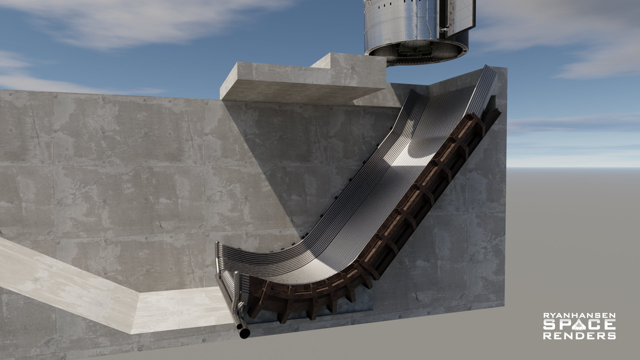
Problem Statement
An effective flame deflector water deluge system is required to control the thermal environment on a launch pad during rocket launches. This system must be capable of withstanding the intense heat and pressure generated by rocket exhaust, while also effectively dissipating and directing the heat away from the launch pad structures. The design parameters are crucial for optimizing flame deflectors and water deluge systems in managing extreme heat during rocket launches. This lack of comprehensive empirical studies focusing on geometric configurations, mass flow rates, temperature on trench , nozzle placements, and timing sequences impedes the development of standardized guidelines for efficiently implementing these critical components across diverse launch environments.

Slide 21
Aim and Objectives
The aim of this study is to undertake design a flame deflector water deluge system to control flow and thermal environment. The objectives of this research work are:
The relationship between water injection momentum and the change in the deflector plate adiabatic wall temperature will be developed.
Water spray schemes analyzed to minimize the water flow and pressure head requirement.
Single and multiple-plane water deluge system configurations studied to limit the water flow and pressure head requirement.
Single and multiple-plane water deluge system configurations with different water spray schemes will be investigated.

Slide 22
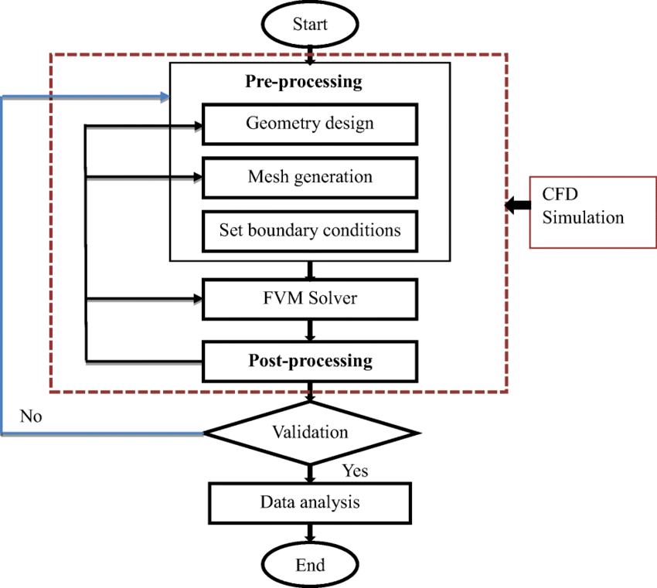
Fig.1 Methodology Flow Chart
Methodology

Slide 23
Continue …
Mathematical Formulation
Water spray cooling involves a variety of physical laws and mathematical models, presented by fundamental fluid flow equations (energy, momentum, and mass conservation equations), turbulence models, multiphase flow equations, and vaporization models.
The equations of the flow field are solved with the finite volume method, the second-order upwind scheme is used in space, and the first-order backward difference scheme is used in time.
The discrete partial differential equations are solved by using the Pressure-Implicit Splitting of Operations (PISO) algorithm for the algebraic system of equations to obtain the numerical solution of the flow field.

Slide 24
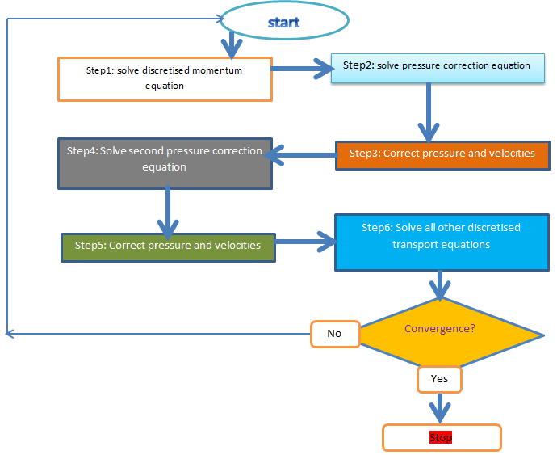
Pressure-Implicit Splitting of Operations (PISO) algorithm
Continue …
Figure 2 : Flow Diagram of PISO Algorithm

Slide 25
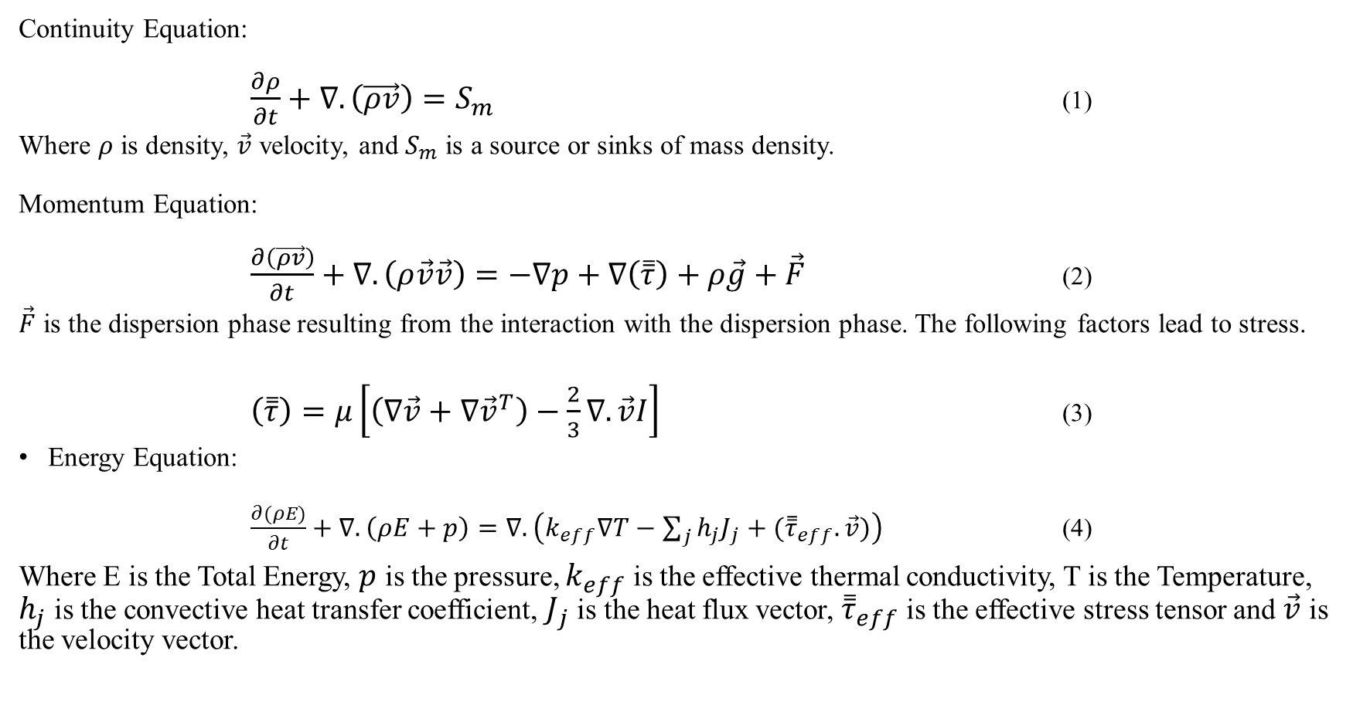
Governing Equations
Continue …
Continuity Equation:
$\frac{∂ρ}{∂t}+∇.\left(\vec{ρv}\right)=S_{m}$ (1)
Where $ρ$ is density, $\vec{v}$ velocity, and $S_{m}$ is a source or sinks of mass density.
Momentum Equation:
$\frac{∂\left(\vec{ρv}\right)}{∂t}+∇.\left(ρ\vec{v}\vec{v}\right)=−∇p+∇\left(\overset{̿}{τ}\right)+ρ\vec{g}+\vec{F}$ (2)
$\vec{F}$ is the dispersion phase resulting from the interaction with the dispersion phase. The following factors lead to stress.
$\left(\overset{̿}{τ}\right)=μ\left[\left(∇\vec{v}+∇{\vec{v}}^{T}\right)−\frac{2}{3}∇.\vec{v}I\right]$ (3)
Energy Equation:
$\frac{∂(ρE)}{∂t}+∇.\left(ρE+p\right)=∇.\left(k_{eff}∇T−\sum_{j}{h_{j}J_{j}+({\overset{̿}{τ}}_{eff}.\vec{v})}\right)$ (4)
Where E is the Total Energy, $p$ is the pressure, $k_{eff}$ is the effective thermal conductivity, T is the Temperature, $h_{j}$is the convective heat transfer coefficient, $J_{j}$ is the heat flux vector, ${\overset{̿}{τ}}_{eff}$ is the effective stress tensor and $\vec{v}$ is the velocity vector.

Slide 26
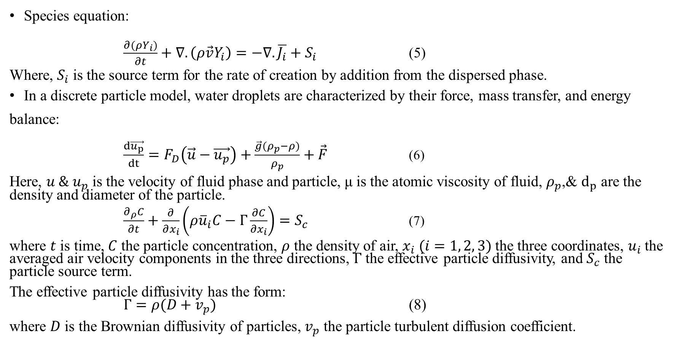
Governing Equations
Continue …
Species equation:
$\frac{∂(ρY_{i})}{∂t}+∇.\left(ρ\vec{v}Y_{i}\right)=−∇.\overline{J_{i}}+S_{i}$ (5)
Where, $S_{i}$ is the source term for the rate of creation by addition from the dispersed phase.
In a discrete particle model, water droplets are characterized by their force, mass transfer, and energy balance:
$\frac{d\vec{u_{p}}}{dt}=F_{D}\left(\vec{u}−\vec{u_{p}}\right)+\frac{\vec{g}(ρ_{p}−ρ)}{ρ_{p}}+\vec{F}$ (6)
Here, $u{ \& u}_{p}$ is the velocity of fluid phase and particle, μ is the atomic viscosity of fluid, $ρ_{p}$,& $d_{p}$ are the density and diameter of the particle.
$\frac{∂_{ρ}C}{∂t}+\frac{∂}{∂x_{i}}\left(ρ{\overline{u}}_{i}C−Γ\frac{∂C}{∂x_{i}}\right)=S_{c}$ (7)
where $t$ is time, $C$ the particle concentration, $ρ$ the density of air, $x_{i} (i=1, 2, 3)$the three coordinates, $u_{i}$the averaged air velocity components in the three directions, $Γ$ the effective particle diffusivity, and $S_{c}$ the particle source term.
The effective particle diffusivity has the form: $Γ=ρ(D+v_{p})$ (8)
where $D$ is the Brownian diffusivity of particles, $v_{p}$ the particle turbulent diffusion coefficient.
Lagrangian
Eulerian

Slide 27
Continue …
Discrete Phase Model (DPM)
The continuous phase is solved using Navier-Stokes equations. At the same time, the discrete phase is simulated by tracking many particles, bubbles, or droplets passing through the calculated continuous flow field.
A discrete phase model (DPM) is used when the aim is to investigate the behavior of the particles from a Lagrangian view and a discrete perspective.
This method can be made much simpler by ignoring the interaction of particles (as well as droplets and bubbles) with each other.

Slide 28
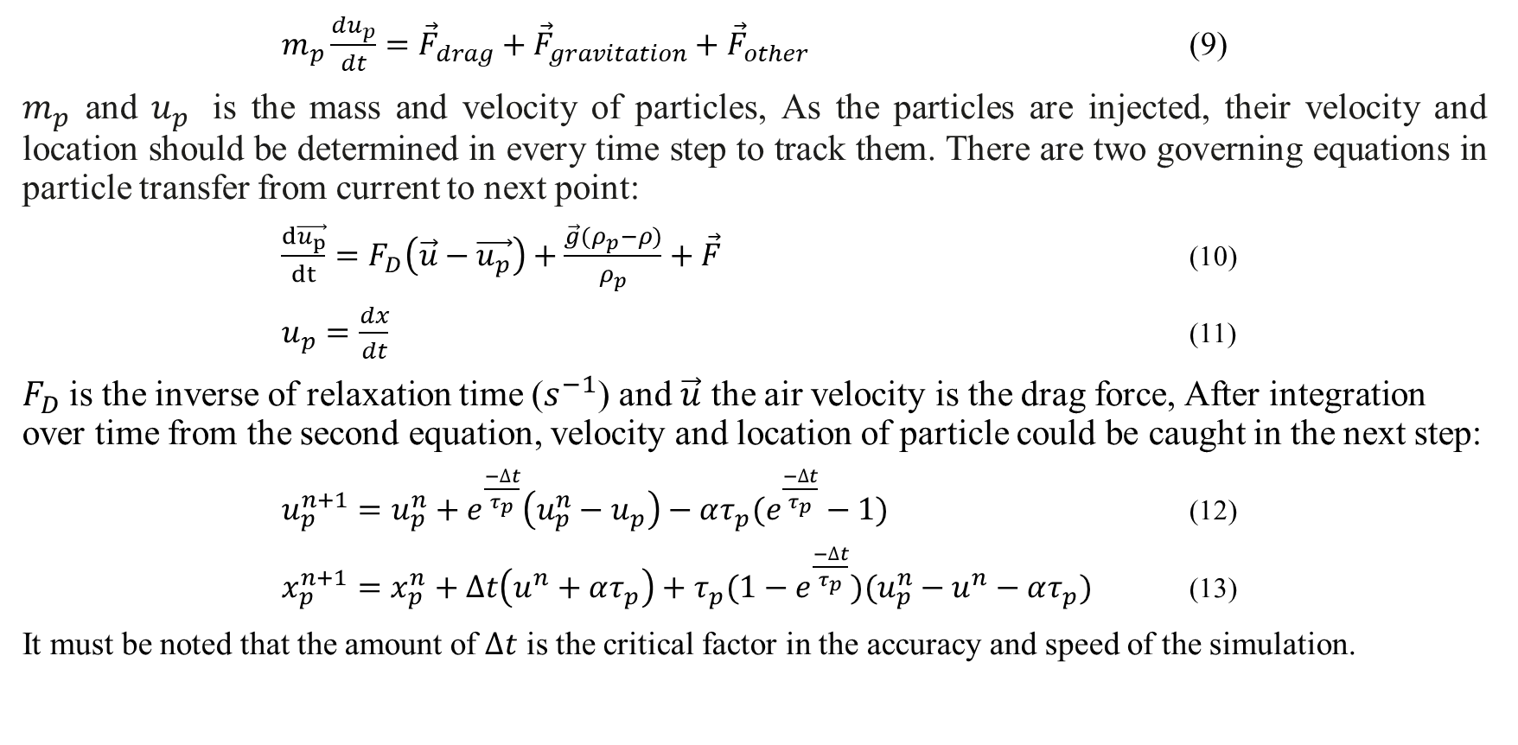
Continue …
Discrete Phase Model (DPM)
$m_{p}\frac{du_{p}}{dt}={\vec{F}}_{drag}+{\vec{F}}_{gravitation}+{\vec{F}}_{other}$ (9)
$m_{p}$ and $u_{p}$ is the mass and velocity of particles, As the particles are injected, their velocity and location should be determined in every time step to track them. There are two governing equations in particle transfer from current to next point:
$\frac{d\vec{u_{p}}}{dt}=F_{D}\left(\vec{u}−\vec{u_{p}}\right)+\frac{\vec{g}(ρ_{p}−ρ)}{ρ_{p}}+\vec{F}$ (10)
$u_{p}=\frac{dx}{dt}$ (11)
$F_{D}$is the inverse of relaxation time ($s^{−1}$) and $\vec{u}$ the air velocity is the drag force, After integration over time from the second equation, velocity and location of particle could be caught in the next step:
$u_{p}^{n+1}=u_{p}^{n}+e^{\frac{−∆t}{τ_{p}}}\left({u_{p}^{n}−u}_{p}\right)−ατ_{p}(e^{\frac{−∆t}{τ_{p}}}−1)$ (12)
$x_{p}^{n+1}=x_{p}^{n}+∆t\left(u^{n}+ατ_{p}\right)+τ_{p}(1−e^{\frac{−∆t}{τ_{p}}})(u_{p}^{n}−u^{n}−ατ_{p})$ (13)
It must be noted that the amount of $∆t$ is the critical factor in the accuracy and speed of the simulation.

Slide 29
Continue …
Discrete Phase Model (DPM)
The difference between the Lagrangian and the Eulerian.
Fluid behavior in the Lagrangian is examined based on particle tracking of a particulate flow.
Fluid behavior is considered in the Eulerian, based on the assumption of a finite volume element in the fluid flow path.

Slide 30
Significance of the study

Slide 31


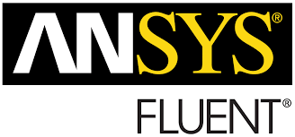


Tools will be used in the present study

Slide 32
Work Plan
Activities/Targets | 2023 |  |  | 2024 |  |  |  | 2025
 | 1st | 2nd | 3rd | 1st | 2nd | 3rd | 4th | 1st | 2nd | 3rd | 4th
Elective Courses
Proposal Write up and submission
Comprehensive Examination
Initial Seminar
Achievement of 1st and 2nd Objective.
1st Progressive Seminar
Achievement of 3rd objective
2nd Progressive Seminar
Achievement of 4th
Thesis Write up
Thesis submission and Open Defense

Slide 33
References
[1] T. Luo, K. Wang, and M. Yao, “Effect of water injection on the cooling performance of flame deflector in rocket engine testing platform,” Applied Thermal Engineering, vol. 236, no. PC, p. 121687, (2024), doi: 10.1016/j.applthermaleng.2023.121687.
[2] Luo, Tianpei, Jiaxian Zhang, and Mingfa Yao. "Investigation on the flow and heat transfer characteristics in a flame deflector with different water injection schemes." Advances in Space Research 72, no. 9 (2023): 3551-3568.
[3] Zhou, Zhitan, Yiying Bao, Peijie Sun, and Yiqing Li. "Cooling of rocket plume using aqueous jets during launching." Engineering Applications of Computational Fluid Mechanics 16, no. 1 (2022): 20-35.
[4] Sharma, Abhishek, T. John Tharakan, and S. Sunil Kumar. "Analysis for design optimization of high thrust liquid engine hot test facility." Acta Astronautica 193 (2022): 653-666.
[5] Zhou, Zhitan, Limin Wang, Yiqing Li, Shuaixing Feng, and Xiangyu Ding. "Effect of uplift angle on thermal environment of flame deflector during rocket launch." Advances in Space Research 71, no. 10 (2023): 4127-4141.

Slide 34
References
[6] Su, Yifei, Xuxin Lu, Guigao Le, Guanghua Li, and Benshuai Fu. "Numerical simulations of seawater spraying on launch platform during CZ-8X offshore launching." Advances in Space Research 72, no. 9 (2023): 3631-3644.
[7] Zhou, Zhitan, Chenyu Lu, Changfang Zhao, and Guigao Le. "Numerical simulations of water spray on flame deflector during the four-engine rocket launching." Advances in Space Research 65, no. 4 (2020): 1296-1305.
[8] Zhang, Manman, Yi Jiang, Jingli Zhang, Jing Lei, and Yueguang Deng. "Research on the cooling effect of water injection of the deflector on flame of the vertical launch missile." In Journal of Physics: Conference Series, vol. 2508, no. 1, p. 012028. IOP Publishing, 2023.
[9] Zhou, Zhitan, Xin Wang, Chenyu Lu, and Guigao Le. "Numerical analysis on thermal environment of liquid rocket with afterburning under different altitudes." Applied Thermal Engineering 178 (2020): 115584.
[10] Salehian, Saman, and Reda R. Mankbadi. "Simulations of rocket launch noise suppression with water injection from impingement pad." International Journal of Aeroacoustics 19, no. 3-5 (2020): 207-239.

Slide 35
References
[11] Raoult, Fabien, Stéphanie Lacour, Bertrand Carissimo, François Trinquet, Anthony Delahaye, and Laurence Fournaison. "CFD water spray model development and physical parameter study on the evaporative cooling." Applied Thermal Engineering 149 (2019): 960-974.
[12] Nili Bachchan, Oshin Peroomian, and Vedat Akdag. "Multiphase modeling of water injection on flame deflector." In 21st AIAA computational fluid dynamics conference, p. 2592. 2013.
[13] Montazeri, Hamid, Bert Blocken, and J. L. M. Hensen. "Evaporative cooling by water spray systems: CFD simulation, experimental validation and sensitivity analysis." Building and environment 83 (2015): 129-141.
[14] Ruan, Yixiao, Yu Hou, Rong Xue, Gaoqiao Luo, Kuizhang Zhu, Xiufang Liu, and Liang Chen. "Effects of operational parameters on liquid nitrogen spray cooling." Applied Thermal Engineering 146 (2019): 85-91.
[15] Raoult, Fabien, Stéphanie Lacour, Bertrand Carissimo, François Trinquet, Anthony Delahaye, and Laurence Fournaison. "CFD water spray model development and physical parameter study on the evaporative cooling." Applied Thermal Engineering 149 (2019): 960-974.

Slide 36
References
[16] Zhang, J. J., Z. G. Qu, R. P. Fu, and Y. L. He. "Experimental study on the transient thermal characteristics of an integrated deflector under the periodic impingement of a supersonic flame jet." International Journal of Heat and Mass Transfer 85 (2015): 811-823.
[17] Lamini, O., R. Wu, C. Y. Zhao, and Z. G. Xu. "Enhanced heat spray cooling with a moving nozzle." Applied Thermal Engineering 141 (2018): 921-927.
[18] Oh, Hwayoung, Jungil Lee, Hyungsik Um, and Hwanil Huh. "Numerical study for flame deflector design of a space launch vehicle." Advances in Space Research 59, no. 7 (2017): 1833-1847.
[19] Al-Zubaydi, Ahmed Y. Taha, and Guang Hong. "Experimental study of a novel water-spraying configuration in indirect evaporative cooling." Applied Thermal Engineering 151 (2019): 283-293.
[20] Yang, Kan, Yanhui Qiang, Chenghang Zhong, and Shaozhen Yu. "Study on the effect of water injection momentum on the cooling effect of rocket engine exhaust plume." In Journal of Physics: Conference Series, vol. 916, no. 1, p. 012047. IOP Publishing, 2017.

Slide 37
References
[21] Yi, Jiang, Ma Yanli, Wang Weichen, and Shao Liwu. "Inhibition effect of water injection on afterburning of rocket motor exhaust plume." Chinese Journal of Aeronautics 23, no. 6 (2010): 653-659.
[22] Li, Jing, Yi Jiang, Shaozhen Yu, and Fan Zhou. "Cooling effect of water injection on a high-temperature supersonic jet." Energies 8, no. 11 (2015): 13194-13210.
[23] S. Sankaran, J. K. Ignatius, R. Ramkumar, T. N. V Satyanarayana, S. R. Chakravarthy, and N. R. Panchapakesan, “Suppression of high mach number rocket jet noise by water injection,” Journal of Spacecraft and Rockets, vol. 46, no. 6, pp. 1164–1170, 2009
[24] Y. Ruan et al., “Effects of operational parameters on liquid nitrogen spray cooling,” Applied Thermal Engineering, vol. 146, pp. 85–91, 2019.
[25] J.-E. Schumann, M. Fertig, V. Hannemann, T. Eggers, and K. Hannemann, “Numerical investigation of space launch vehicle base flows with hot plumes,” Futur. Space-Transport-System Components under High Therm. Mech. Loads Results from DFG Collab. Research Centre. TRR40, pp. 179–191, 2021.

Slide 38
References
[26] Sharma, A., D. K. Agarwal, and J. C. Pisharady. "Analysis of flame deflector pit simulator for semi-cryogenic engine test facility." In Proceedings of the International Astronautical Congress, IAC, International Astronautical Federation, IAF. 2016.
[27] Lu, Chenyu, Zhitan Zhou, Yue Shi, Yiying Bao, and Guigao Le. "Numerical simulations of water spray on launch pad during rocket launching." Journal of Spacecraft and Rockets 58, no. 2 (2021): 566-574.
[28] Zhou, Zhitan, Peijie Sun, and Yiying Bao. "Numerical simulations of thermal environment of the rocket impingement jet with afterburning under different water spray angles." Aerospace Science and Technology 121 (2022): 107308.
[29]

Slide 39
Thank you

